Slide 1
Node.js

Slide 2
Introduction
Node.js is an open source server environment.
Node.js allows you to run JavaScript on the server.
Node.js runs on various platforms (Windows, Linux, Unix, Mac OS X, etc.)
Why Node.js?
It uses asynchronous programming.
A common task for a web server can be to open a file on the server and return the content to the client.
Here is how Node.js handles a file request:
Sends the task to the computer's file system.
Ready to handle the next request.
When the file system has opened and read the file, the server returns the content to the client.
Node.js eliminates the waiting, and simply continues with the next request.
Node.js runs single-threaded, non-blocking, asynchronous programming, which is very memory efficient.

Slide 3
What Can Node.js Do?
Node.js can generate dynamic page content
Node.js can create, open, read, write, delete, and close files on the server
Node.js can collect form data
Node.js can add, delete, modify data in your database
What is a Node.js File?
Node.js files contain tasks that will be executed on certain events
A typical event is someone trying to access a port on the server
Node.js files must be initiated on the server before having any effect
Node.js files have extension ".js"

Slide 4
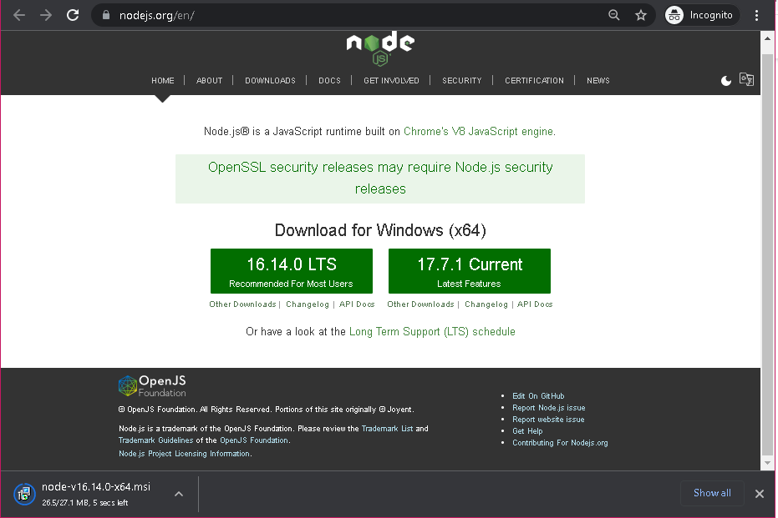
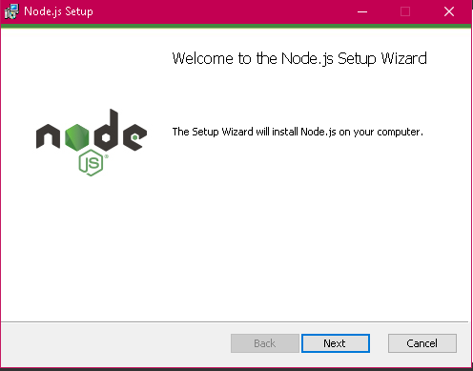
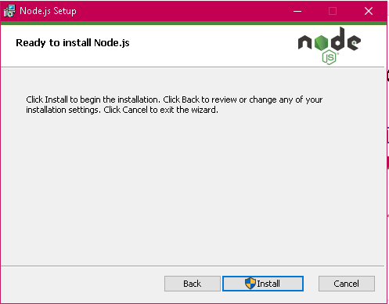
Getting started with Node.js
Download and install for Node.js: https://nodejs.org

Slide 5
